Slide 1



Project planning: software set-up
PHP, HTML, & CSS
mySQL
Version control system
& repository

Slide 2

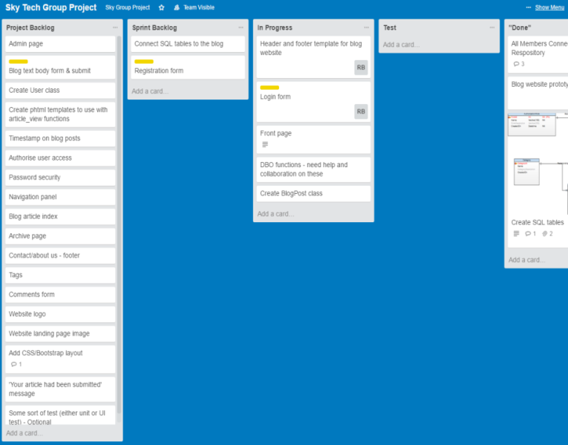
Project management: methodology
Adapted Agile SCRUM methodology
Initial planning session to create Project Backlog
3 sprints + sprint review meetings
Daily contact
For task management during sprints, we used Trello:
Project backlog
Sprint backlog
In Progress
Test
“Done”

Slide 3
Challenges
Lack of technical knowledge
Zero previous experience of coding, website design, SCRUM…
Utilised a variety of sources: course materials, tutorials, forum posts, and other sources of information on the web
Trial and error!
Communication
Division of labour
Keeping each other updated and involved
Primarily solved by using Hangouts and meeting weekly in person

Slide 4

Coming soon…
Adding video content to the site
Authorised users can embed video content with their blog posts using an upload form
Can contain tours, reviews, and travel segments to bring the content to life
Will be created using HTML5 and have JavaScript properties

